Slide 1

CALLABLE BONDS
Detailed explanation of the model and pricer
JULY 26, 2024
DELOITTE LUXEMBOURG
Author: Jiaqi Xia
07/10/2024

Slide 2
Global Overview

Slide 3
Callable Bond : Definition
A callable bond, also known as a redeemable bond, is a bond that the issuer may redeem before it reaches the stated maturity date. A callable bond allows the issuing company to pay off its debt early. A business may choose to call its bond if market interest rates move lower, which allows them to re-borrow at a more advantageous rate. Callable bonds thus compensate investors for this potentiality by typically offering a more attractive interest rate or coupon rate due to their callable nature.

Slide 4

Vanilla Bond
Key Parameters:
Key Parameters:
Market Value: The current market value of the bond in the portfolio.
Face Value: The face value or par value of the bond, which is the amount the issuer agrees to repay the bondholder at maturity.
Redemption Rate: The ratio of final principal payment / Face value. Most of bonds have a redemption rate of 1.
Time to Maturity: The time remaining until the bond matures, typically expressed in years.
Coupon Rate: The annual coupon rate of the bond, expressed as a percentage of the face value. This defines the periodic coupon payments made to bondholders.
Coupon Frequency: The frequency of coupon payments per year (e.g., semi-annual = 2, quarterly = 4).
currency: The currency of the payments. This would indicate the exchange rate to use to convert bond value in instrument currency to portfolio currency. This also indicate which swap curve and historical interest rate dynamic to use. (See model calibration)
Credit Quality Step: A standardized indicator of Credit Risk. The CQS Credit Rating Scale is based on numbers, ranging from 1 to 6. 1 is the highest quality, 6 is the lowest quality

Slide 5
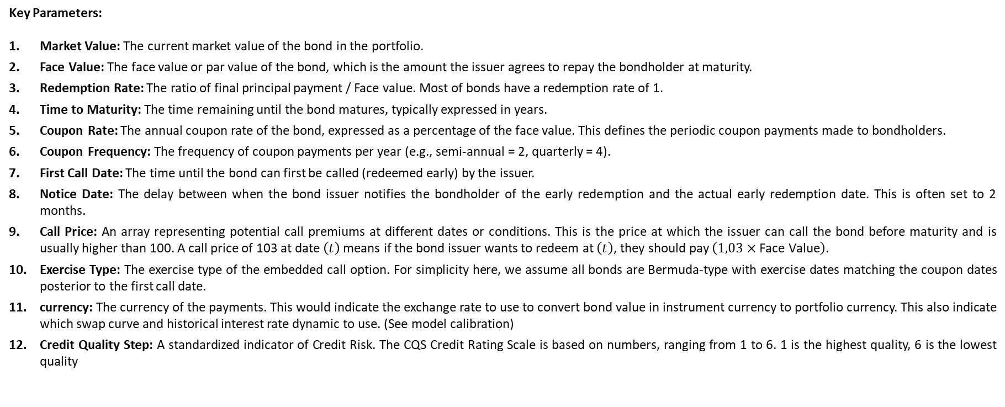
Callable Bond
Key Parameters:
Key Parameters:
Market Value: The current market value of the bond in the portfolio.
Face Value: The face value or par value of the bond, which is the amount the issuer agrees to repay the bondholder at maturity.
Redemption Rate: The ratio of final principal payment / Face value. Most of bonds have a redemption rate of 1.
Time to Maturity: The time remaining until the bond matures, typically expressed in years.
Coupon Rate: The annual coupon rate of the bond, expressed as a percentage of the face value. This defines the periodic coupon payments made to bondholders.
Coupon Frequency: The frequency of coupon payments per year (e.g., semi-annual = 2, quarterly = 4).
First Call Date: The time until the bond can first be called (redeemed early) by the issuer.
Notice Date: The delay between when the bond issuer notifies the bondholder of the early redemption and the actual early redemption date. This is often set to 2 months.
Call Price: An array representing potential call premiums at different dates or conditions. This is the price at which the issuer can call the bond before maturity and is usually higher than 100. A call price of 103 at date $\left(t\right)$ means if the bond issuer wants to redeem at $\left(t\right)$, they should pay $\left(1,03×\text{Face} \text{Value}\right)$.
Exercise Type: The exercise type of the embedded call option. For simplicity here, we assume all bonds are Bermuda-type with exercise dates matching the coupon dates posterior to the first call date.
currency: The currency of the payments. This would indicate the exchange rate to use to convert bond value in instrument currency to portfolio currency. This also indicate which swap curve and historical interest rate dynamic to use. (See model calibration)
Credit Quality Step: A standardized indicator of Credit Risk. The CQS Credit Rating Scale is based on numbers, ranging from 1 to 6. 1 is the highest quality, 6 is the lowest quality

Slide 6
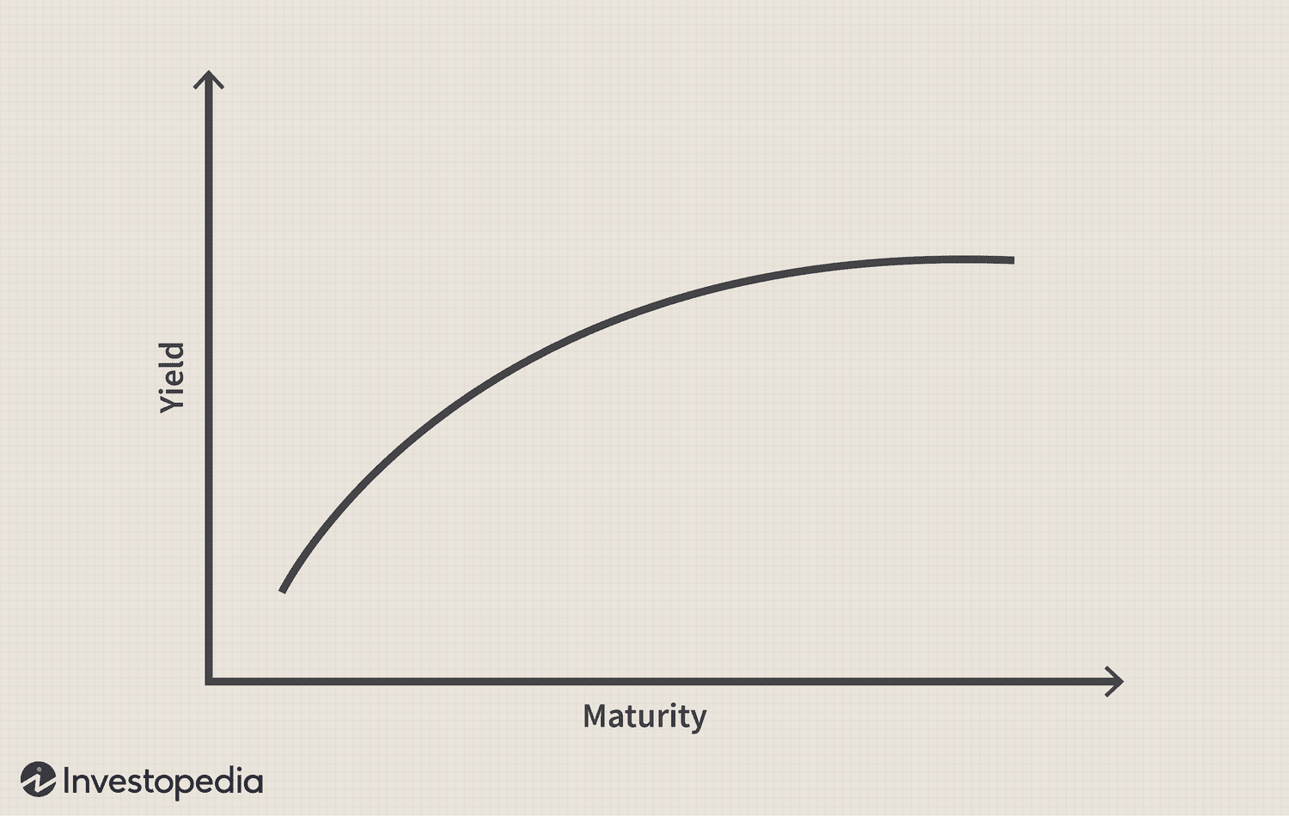

Vanilla Bond price
The present value is the sum of actualized future cashflows.
The actualization use the risk-free yield curve and implied spread. We uses continuous compounding.
For simplification, in the all following, we consider unit bond : Face value = 1.
$$P_{t} =\sum_{i=1}^{f∗T}{\frac{C}{f}e^{−{(Y}_{t,\frac{i}{f}}+IS)i/f}}\text{+ }\text{R}e^{−{(Y}_{t,T}+IS)T}$$
$$Where:$$
$$P : price of the bond$$
$$C\text{ : }\text{Coupon} \text{Rate}$$
$$Y_{t1,t2}:Risk Free Yield for maturity t_{2} at time t_{1}$$
$$f :\text{Coupon} \text{Frequency}$$
$$T :\text{Time} \text{to} \text{Maturity}$$
$$R :\text{Redemption} \text{Rate}.$$
$$IS :Implied Spread$$

Slide 7
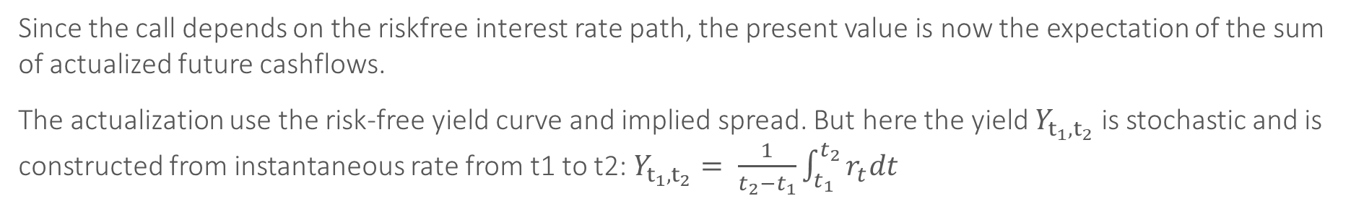

Callable Bond price
Since the call depends on the riskfree interest rate path, the present value is now the expectation of the sum of actualized future cashflows.
The actualization use the risk-free yield curve and implied spread. But here the yield $Y_{t_{1},t_{2}}$ is stochastic and is constructed from instantaneous rate from t1 to t2: $Y_{t_{1},t_{2}}= \frac{1}{t_{2}−t_{1}}\int_{t_{1}}^{t_{2}}{r_{t}dt}$
$$P_{t} =E\left[\sum_{i=1}^{f∗T}{\frac{C}{f}e^{−{(Y}_{\frac{i}{f}}+IS)i/f}}\text{+ }\text{R}e^{−{(Y}_{T}+IS)T} ∣ F_{t}\right]$$
$$Where:$$
$$P : price of the bond$$
$$C\text{ : }\text{Coupon} \text{Rate}$$
$$r_{t}:Instantaneous riskfree rate at t$$
$$f :\text{Coupon} \text{Frequency}$$
$$T :\text{Time} \text{to} \text{Maturity}$$
$$R :\text{Redemption} \text{Rate}.$$
$$IS :Implied Spread$$

Slide 8
Interest rate Models
As the price of a callable bond is written as an expectation, we choose to use Monte Carlo simulations to compute it. The computation uses a large number of interest rate trajectories generated from a given instantaneous rate model.

Slide 9
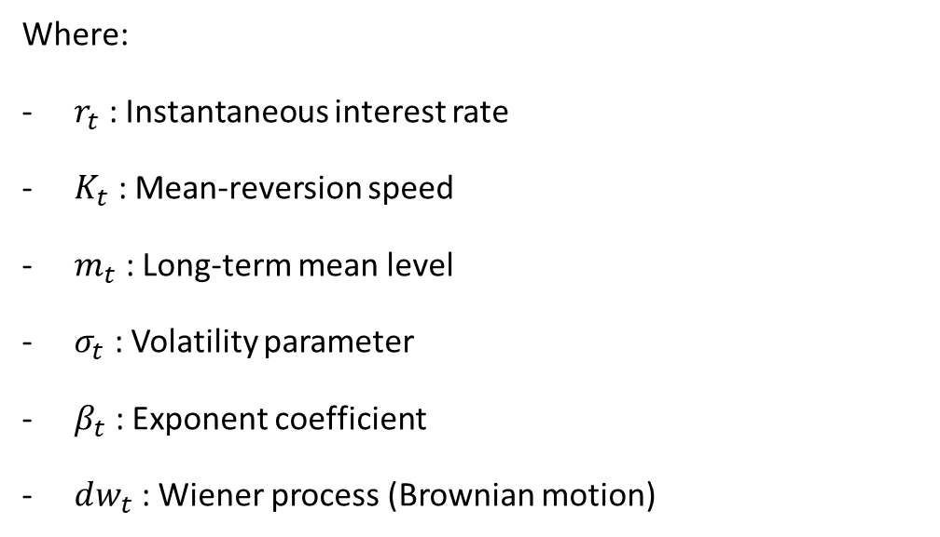
Mean reverting diffusion models :
A general family of models
The general standard stochastic differential equation (SDE) for this family of models is:
$$d_{r_{t}}=K_{t}\left(m_{t} −r_{t}\right)dt+ {σ_{t}r}_{t}^{β_{t}}dw_{t}$$
Where:
$r_{t}$​ : Instantaneous interest rate
$K_{t}$ : Mean-reversion speed
$m_{t}$ : Long-term mean level
$σ_{t}$ : Volatility parameter
$β_{t}$ : Exponent coefficient
$dw_{t}$ : Wiener process (Brownian motion)
All these parameters are time dependent and could have their own dynamic.

Slide 10

Classical Existing Instantaneous rate models
Some specific cases of the mean reverting diffusion models
Scaled Brownian motion
$$d_{r_{t}}= σdw_{t}$$
Vasicek
$d_{r_{t}}=K\left(m −r_{t}\right)dt+ σdw_{t}$
D_
CIR (Cox-Ingersoll-Ross)
$$d_{r_{t}}=K\left(m −r_{t}\right)dt+ {σr}_{t}^{0.5}dw_{t}$$
CEV(Constant elasticity of Variance)
$$d_{r_{t}}=K\left(m −r_{t}\right)dt+ σr_{t}^{β}dw_{t}$$
three-factor model of Anderson & Lund
$$d_{r_{t}}=K_{1}\left(m_{t} −r_{t}\right)dt+ {σ_{t}r}_{t}^{β}dw_{1,t}$$
$$d_{\log{σ_{t}^{2}}}=K_{2}\left(α −\log{σ_{t}^{2}}\right)dt+ ε_{1}dw_{2,t}$$
$$d_{m_{t}}=K_{3}\left( θ−m_{t}\right)dt+ {ε_{2}r}_{t}^{0.5}dw_{3,t}$$

Slide 11
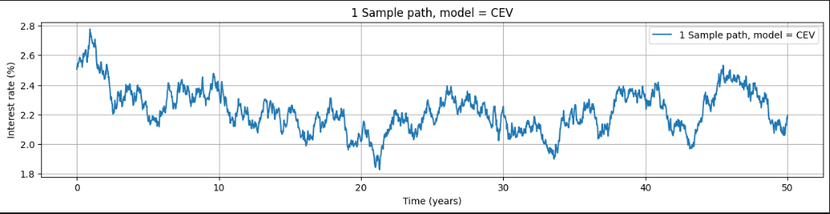
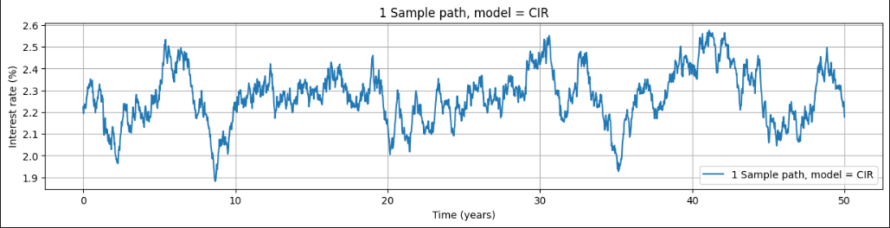
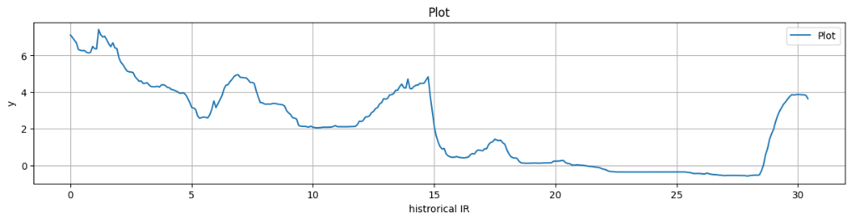
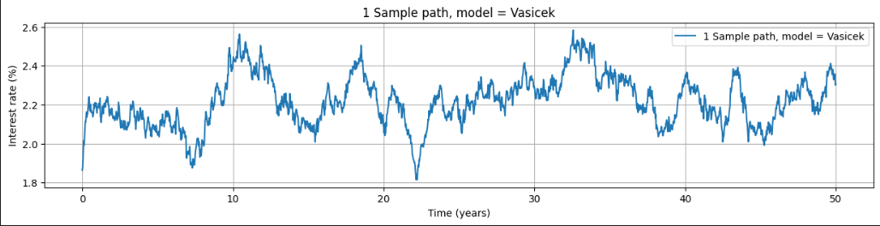
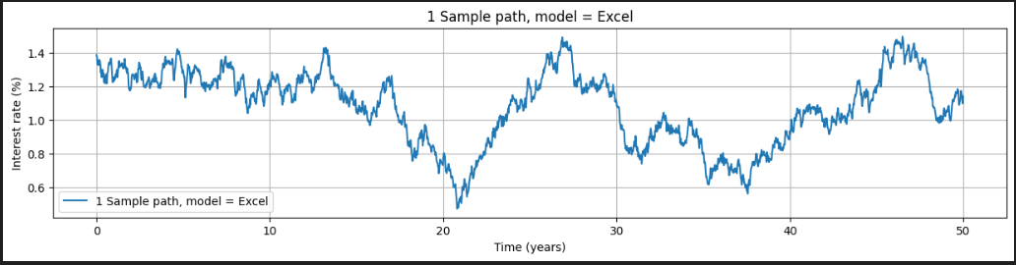
Existing Models vs reality
Historical rate (EUR)

Slide 12
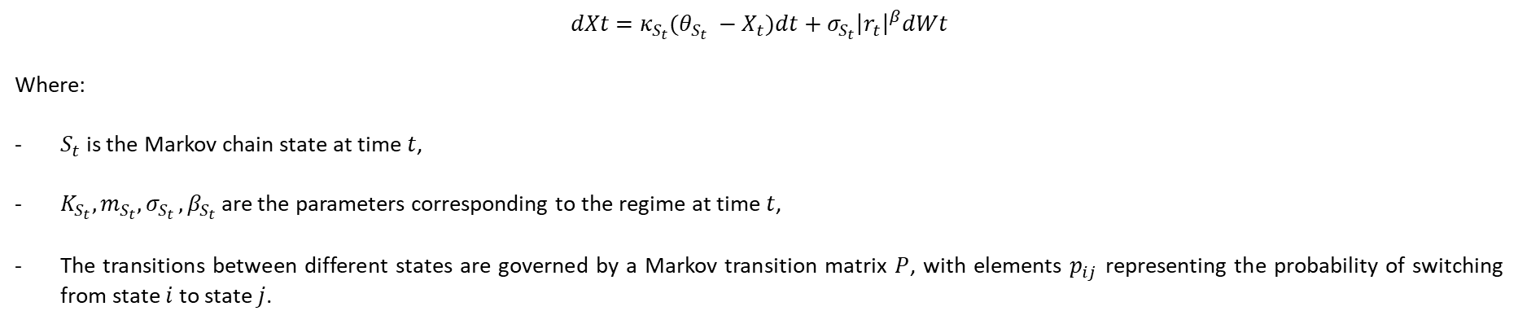
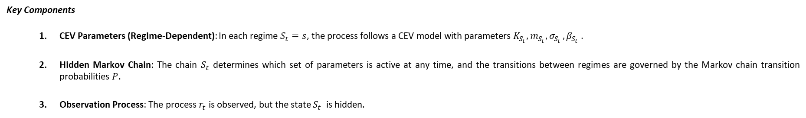
Hidden Markov CEV model (HMCEV)
In the Hidden Markov CEV model, the parameters of the CEV model (K$,m,σ, β$) are assumed to change according to a hidden Markov chain. This allows the model to capture regime-switching behavior, where the process can transition between different states, each with its own set of parameters. In addition, we use $​​{\left|r_{t}\right|}^{β}$ instead of $​​r_{t}^{β}$ to allow negative interest rates.
$$dXt​=κ_{S_{t}}​(θ_{S_{t}} ​​−X_{t}​)dt+σ_{S_{t}}​​{\left|r_{t}\right|}^{β}dWt​$$
Where:
$S_{t}$​ is the Markov chain state at time $t$,
$K_{S_{t}}​​,m_{S_{t}}​​,σ_{S_{t }},β_{S_{t}}$​​ are the parameters corresponding to the regime at time $t$,
The transitions between different states are governed by a Markov transition matrix $P$, with elements $p_{ij}$​ representing the probability of switching from state $i$ to state $j$.
Key Components
CEV Parameters (Regime-Dependent): In each regime $S_{t}=s$, the process follows a CEV model with parameters $K_{S_{t}}​​,m_{S_{t}}​​,σ_{S_{t }},β_{S_{t}}$ .
Hidden Markov Chain: The chain $S_{t}$​ determines which set of parameters is active at any time, and the transitions between regimes are governed by the Markov chain transition probabilities $P$.
Observation Process: The process $r_{t}$​ is observed, but the state $S_{t}$ ​ is hidden.

Slide 13
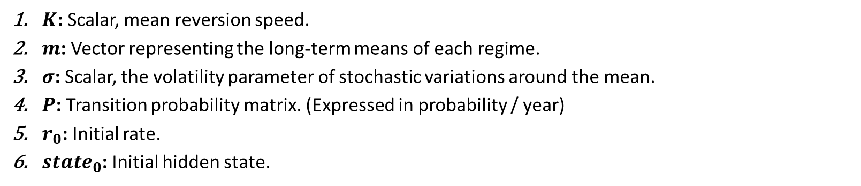
HMCEV
HMCIR Parameters
In our case : For simplification, since we observe the most notable parameter that seem to vary according to regime it the long-term average $m_{S_{t}}$ ,we suppose that $K_{S_{t}}​​ ​​,σ_{S_{t }},β_{S_{t}}$ are the same for all regimes
Finally, we have
$K$: Scalar, mean reversion speed.
$m$: Vector representing the long-term means of each regime.
$σ$: Scalar, the volatility parameter of stochastic variations around the mean.
$P$: Transition probability matrix. (Expressed in probability / year)
$r_{0}$: Initial rate.
$state_{0}$: Initial hidden state.

Slide 14

HMCEV
Interest rate paths simulation
By discretizing the HMCIR SDE, after fixing an initial rate and state, we simulate paths of $n+1$steps over a time of $T$ years. ( $Δt=\frac{T}{n}$)
$$r_{t_{i+1}}=r_{t_{i}}+κ_{S_{t_{i}}}\left(θ_{S_{t_{i}}}−r_{t}\right)Δt+σ_{S_{t_{i}}}{\left|r_{t_{i}}\right|}^{β}𝒩\left(0,1\right)Δt^{0.5}$$
The hidden state is not updated each step, but only a certain number $n_rev$ per year with the matrix $P^{\left( \frac{1}{n_{rev}} \right)}$
The whole process is vectorialized to simulate $N$ paths in parallel.
Image of large number of paths

Slide 15
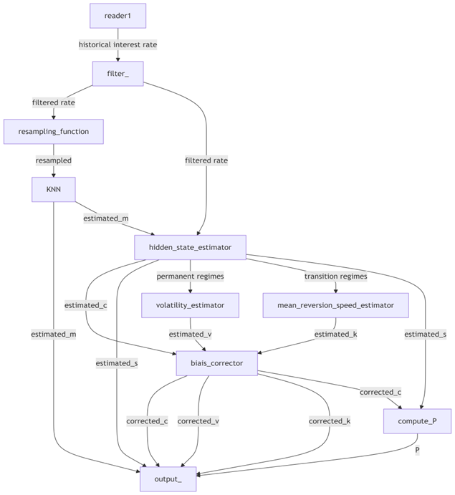
Model Calibration HMCEV
Workflow overview

Slide 16

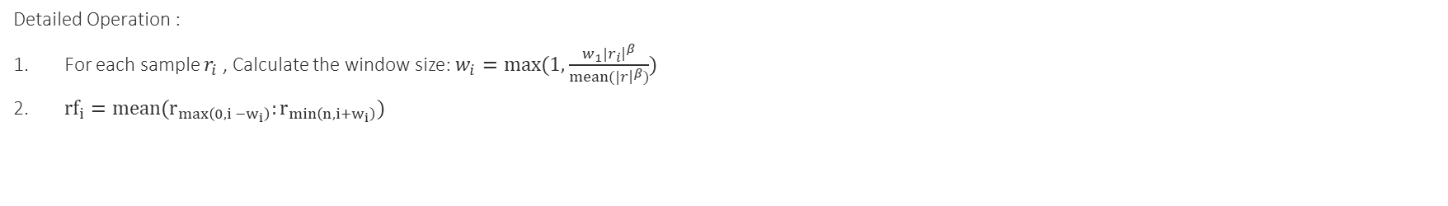

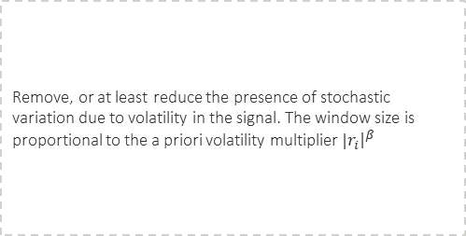
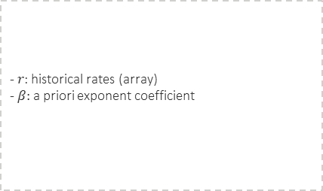
Model Calibration HMCEV
Filter Module
Category II
Input
Hyperparameters
Output
Purpose
- $r$: historical rates (array)
- $β:$ a priori exponent coefficient
$w_{1}$ : filter windows half-size (scalar)
$rf:$filtered rates (array)
Remove, or at least reduce the presence of stochastic variation due to volatility in the signal. The window size is proportional to the a priori volatility multiplier ${|r}_{i}{\left.​\right|}^{β}$
Detailed Operation :
For each sample $r_{i}$, Calculate the window size: $w_{i}=max⁡(1,\frac{w_{1}{|r}_{i}{\left.​\right|}^{β}}{mean(|r{\left.​\right|}^{β})})$
${rf}_{i}=mean(r_{\max\left(0, i −w_{i}\right)}:r_{\min\left(n,i+w_{i}\right)})$

Slide 17

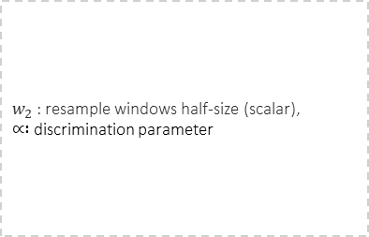
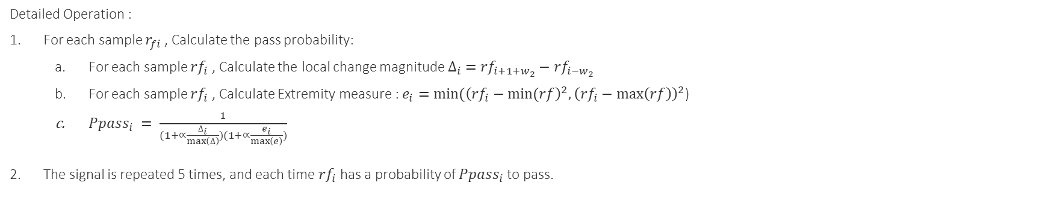

Model Calibration HMCEV
Resample Module
Category II
Input
Hyperparameters
Output
Purpose
- $rf$: filtered rates (array)
$w_{2}$ : resample windows half-size (scalar),
$∝ :$discrimination parameter
s$r$ resampled rates (array)
Resample data by keeping the most "relevant" points for KMeans. Points with extreme values or those in a permanent regime are more likely to be retained.*
Detailed Operation :
For each sample $r_{fi}$, Calculate the pass probability:
For each sample ${rf}_{i}$, Calculate the local change magnitude $∆_{i} ={rf}_{i+1+w_{2}}−{rf}_{i−w_{2}}$
For each sample ${rf}_{i}$, Calculate Extremity measure : $e_{i}=min⁡({\left({rf}_{i}−min⁡(rf\right)}^{2},{\left({rf}_{i}−\max\left(rf\right)\right)}^{2}$)
$Ppass_{i} = \frac{1}{\begin{aligned}(1+∝\frac{∆_{i}}{\max\left(∆\right)})(1+∝\frac{e_{i}}{\max\left(e\right)}) \\ \end{aligned}}$
The signal is repeated 5 times, and each time ${rf}_{i}$has a probability of $Ppass_{i}$ to pass.

Slide 18

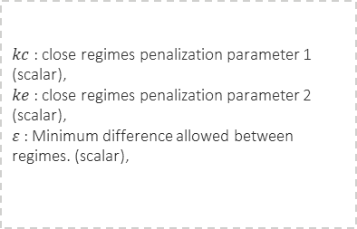
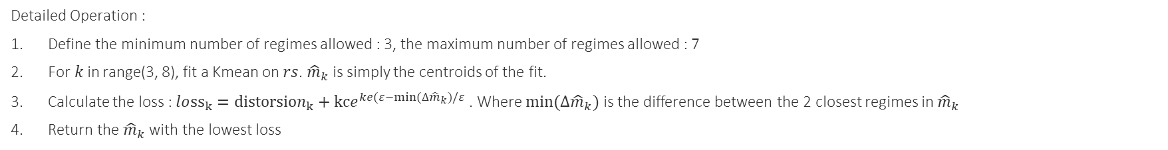

Model Calibration HMCEV
m-Estimator Module
Category II
Input
Hyperparameters
Output
Purpose
-$rs$ : resampled rates (array)
$kc$ : close regimes penalization parameter 1 (scalar),
$ke$ : close regimes penalization parameter 2 (scalar),
$ε$ : Minimum difference allowed between regimes. (scalar),
$\hat{m}$ : estimated m (array)
Estimate the means of different regimes in the HMCIR model using K-means clustering.
Aims to minimize distortion while penalizing the existence of regimes that are too close.
Detailed Operation :
Define the minimum number of regimes allowed : 3, the maximum number of regimes allowed : 7
For$k$in range(3, 8), fit a Kmean on $rs$. ${\hat{m}}_{k}$ is simply the centroids of the fit.
Calculate the loss : $lo{ss}_{k}={distorsion}_{k}+kce^{ke(ε−min⁡(∆{\hat{m}}_{k})/ε}$ . Where $min⁡(∆{\hat{m}}_{k})$ is the difference between the 2 closest regimes in ${\hat{m}}_{k}$
Return the ${\hat{m}}_{k}$ with the lowest loss
K-means clustering is an unsupervised machine learning algorithm that groups similar data points into K distinct clusters. The algorithm wants to minimize the distance between data points within the same cluster and maximize the distance between data points in different clusters. K-Means Algorithm (with example). Introduction | by Lea Setruk | Medium

Slide 19
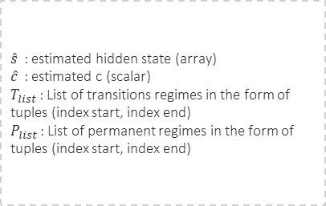
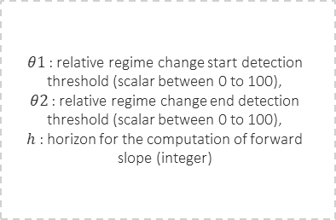
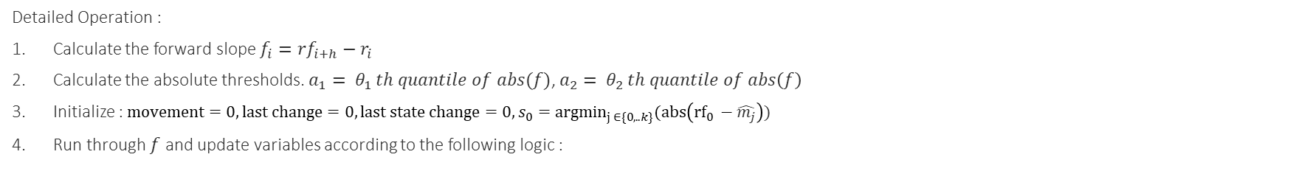

Model Calibration HMCEV
Hidden state estimation Module
Category II
Input
Hyperparameters
Output
Purpose
- $rf$: filtered rates (array)
- $\hat{m}$ : estimated m (array)
$θ1$ : relative regime change start detection threshold (scalar between 0 to 100),
$θ2$ : relative regime change end detection threshold (scalar between 0 to 100),
$h$ : horizon for the computation of forward slope (integer)
$\hat{s}$ : estimated hidden state (array)
$\hat{c}$ : estimated c (scalar)
$T_{list}$ : List of transitions regimes in the form of tuples (index start, index end)
$P_{list}$ : List of permanent regimes in the form of tuples (index start, index end)
Estimate the hidden state at each step, count the number of regime switch and give the list of transition regimes (When the regime just switched, and the rates are evolving toward the mean of the new regime) and permanent regime. (when the rates reached the neighborhoods of the new regime means and evolve near it)
Detailed Operation :
Calculate the forward slope $f_{i}={rf}_{i+h}−r_{i}$
Calculate the absolute thresholds. $a_{1}= θ_{1 }th quantile of abs(f)$, $a_{2}= θ_{2 }th quantile of abs\left(f\right)$
Initialize : $movement=0, last change=0, last state change=0, s_{0}={argmin}_{j ∈\{0,..k\}}(abs\left({rf}_{0} −\hat{m_{j}}\right))$
Run through $f$ and update variables according to the following logic :

Slide 20
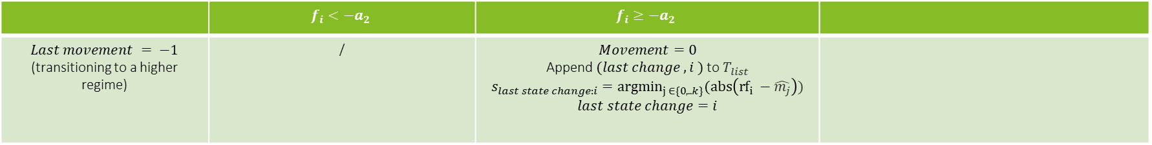
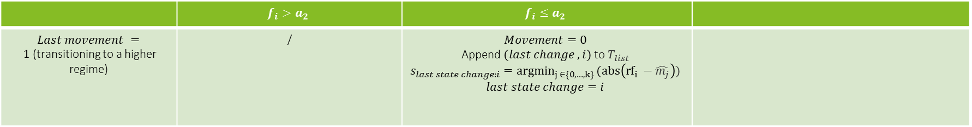
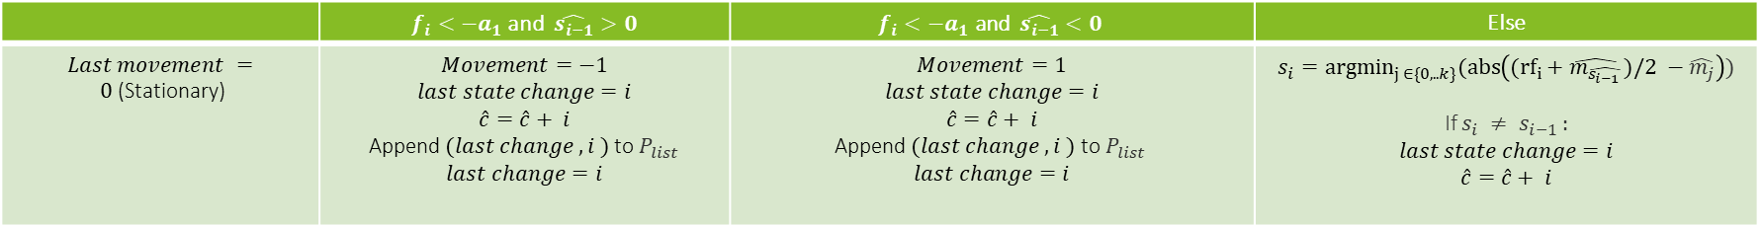
Model Calibration HMCEV
Hidden state estimation Module
Category II
Update logic
 | $$f_{i}<−a_{2}$$ | $$f_{i}≥−a_{2}$$
$Last movement = −1$ (transitioning to a higher regime) | / | $$Movement=0$$ Append $(last change ,i )$to $T_{list}$ $$s_{last state change:i}={argmin}_{j ∈\{0,..k\}}(abs\left({rf}_{i} −\hat{m_{j}}\right))$$ $$last state change=i$$
 | $$f_{i}>a_{2}$$ | $$f_{i}≤a_{2}$$
$Last movement = 1$(transitioning to a higher regime) | / | $$Movement=0$$ Append $(last change ,i)$to $T_{list}$ $$s_{last state change:i}={argmin}_{j ∈\{0,…,k\} }(abs\left({rf}_{i} −\hat{m_{j}}\right))$$ $$last state change=i$$
 | $f_{i}<−a_{1}$ and $\hat{s_{i−1}}>0$ | $$f_{i}<−a_{1} \text{and} \hat{s_{i−1}}<0$$ | Else
$Last movement = 0$(Stationary) | $$Movement=−1$$ $$last state change=i$$ $$\hat{c}=\hat{c}+ i$$ Append $(last change ,i )$to $P_{list}$ $$last change=i$$ | $$Movement=1$$ $$last state change=i$$ $$\hat{c}=\hat{c}+ i$$ $$\text{Append} (last change ,i ) \text{to} P_{list}$$ $$last change=i$$ | $$s_{i}={argmin}_{j ∈\{0,..k\}}(abs\left(({rf}_{i}+\hat{m_{\hat{s_{i−1 }}}})/2 −\hat{m_{j}}\right))$$ If $s_{i} ≠ s_{i−1 }:$ $$last state change=i$$ $$\hat{c}=\hat{c}+ i$$

Slide 21
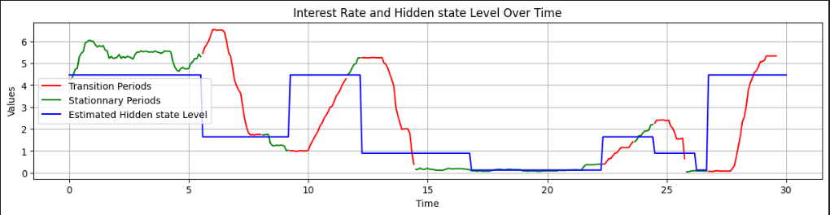
Hidden state estimation

Slide 22
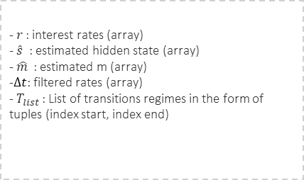
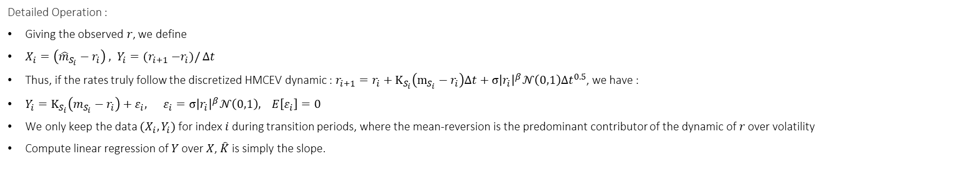


Model Calibration HMCEV
$K$ estimation Module
Category II
Input
Hyperparameters
Output
Purpose
-$r$ : interest rates (array)
$− \hat{s}$ : estimated hidden state (array)
- $\hat{m}$ : estimated m (array)
-$Δt$: filtered rates (array)
- $T_{list}$ : List of transitions regimes in the form of tuples (index start, index end)
$\hat{K}$ : estimated m (array)
Estimate the mean-reversion speed ($K$) of the HMCIR model.
Detailed Operation :
Giving the observed $r$, we define
$X_{i}=\left({\hat{m}}_{S_{i}}−r_{i}\right) , Y_{i}={(r}_{i+1} −r_{i})/$ $Δt$
Thus, if the rates truly follow the discretized HMCEV dynamic : $r_{i+1}=r_{i}+K_{S_{i}}\left(m_{S_{i}}−r_{i}\right)Δt+σ{\left|r_{i}\right|}^{β}𝒩\left(0,1\right)Δt^{0.5}$, we have :
$Y_{i}=K_{S_{i}}\left(m_{S_{i}}−r_{i}\right)$ $+ ε_{i}, ε_{i}=σ{\left|r_{i}\right|}^{β}𝒩\left(0,1\right), E\left[ε_{i}\right]=0$
We only keep the data $(X_{i}, Y_{i})$ for index $i$ during transition periods, where the mean-reversion is the predominant contributor of the dynamic of $r$ over volatility
Compute linear regression of $Y$ over $X$, $\hat{K}$ is simply the slope.

Slide 23
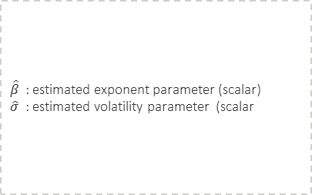

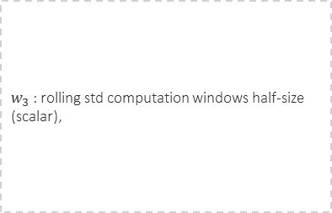

Model Calibration HMCEV
$β$and $σ$ estimation Module
Category II
Input
Hyperparameters
Output
Purpose
-$r$ : interest rates (array)
$− \hat{s}$ : estimated hidden state (array)
- $\hat{m}$ : estimated m (array)
-$Δt$: filtered rates (array)
- $P_{list}$ : List of transitions regimes in the form of tuples (index start, index end)
$w_{3}$ : rolling std computation windows half-size (scalar),
$\hat{β}$ : estimated exponent parameter (scalar)
$\hat{σ}$ : estimated volatility parameter (scalar
Estimate the exponent and volatility parameters of the HMCIR model.
Detailed Operation :
Giving the observed $r$, we define
$X_{i}= \log{|r_{i}|} , Y_{i}=\log{\overline{std_{w3, i}}}$
Thus, if the rates truly follow the discretized HMCEV dynamic : $r_{i+1}=r_{i}+K_{S_{i}}\left(m_{S_{i}}−r_{i}\right)Δt+σ{\left|r_{i}\right|}^{β}𝒩\left(0,1\right)Δt^{0.5}$ , we have :
$Y_{i}=\log{σ}+ βlog{|r_{i}|}, E\left[ε_{i}\right]=0$
We only keep the data $(X_{i}, Y_{i})$ for index $i$ during transition periods, where the mean-reversion is the predominant contributor of the dynamic of $r$ over volatility
Compute linear regression of $Y$ over $X$, $\hat{β}$ is simply the slope and $\hat{σ}= e^{intercept}$ .

Slide 24
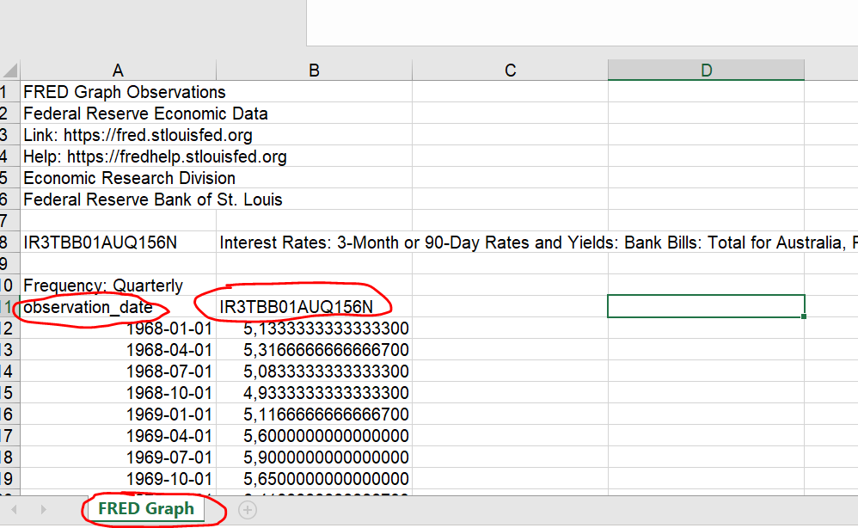
Calibration workflow
1) Follow the links for each main currency
name code of the currency / link
AUD:https://fred.stlouisfed.org/series/IR3TBB01AUQ156N
CAD:…
2)Set the date from 1994-01-01 to the current date
3) download the file in excel
4) Rename the date column to "date", rate column to "rate" and the sheet to "Data"
5) save at scripts\market_data\historical_rates\ name code of the currency.xls
To be done monthly

Slide 25
Performance tests

Slide 26
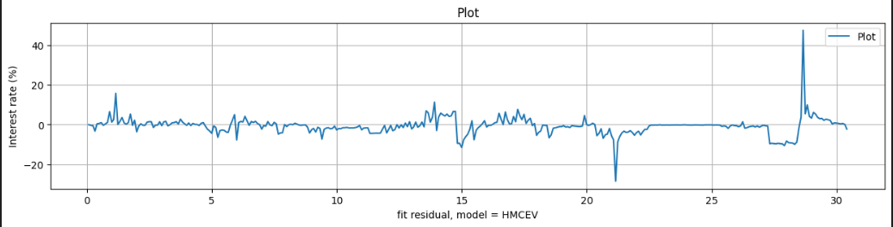
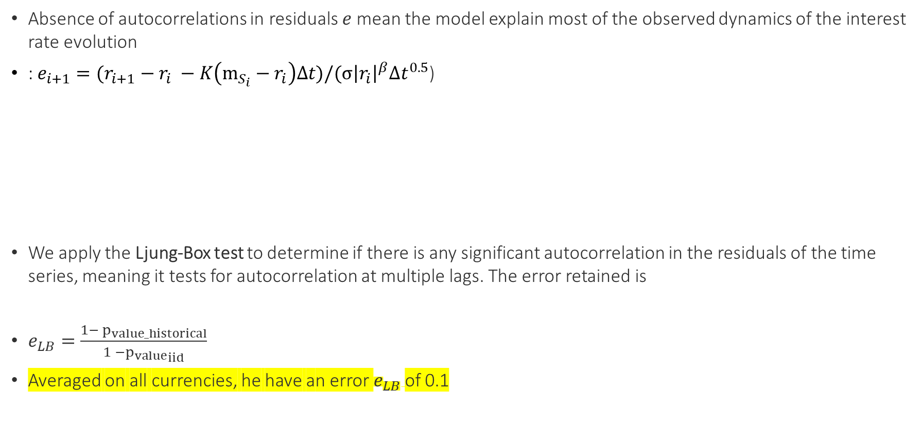
Fit quality
We compare the fitting residuals on historical data to the residuals obtained on a true HMCEV model.
Absence of autocorrelations in residuals $e$ mean the model explain most of the observed dynamics of the interest rate evolution
: $e_{i+1}={{(r}_{i+1} − r}_{i} −K\left(m_{S_{i}}−r_{i}\right)Δt)/(σ{\left|r_{i}\right|}^{β}Δt^{0.5}$)
We apply the Ljung-Box test to determine if there is any significant autocorrelation in the residuals of the time series, meaning it tests for autocorrelation at multiple lags. The error retained is
$e_{LB}=\frac{{1− p}_{value_historical}}{1 −{p_{value}}_{iid}}$
Averaged on all currencies, he have an error $e_{LB}$of 0.1

Slide 27
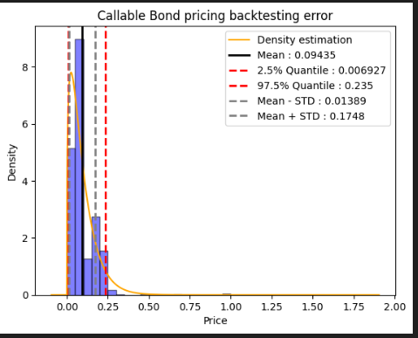
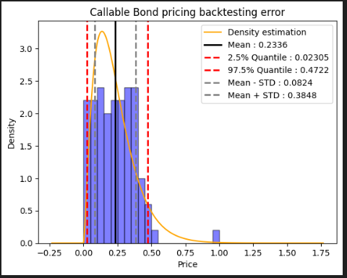
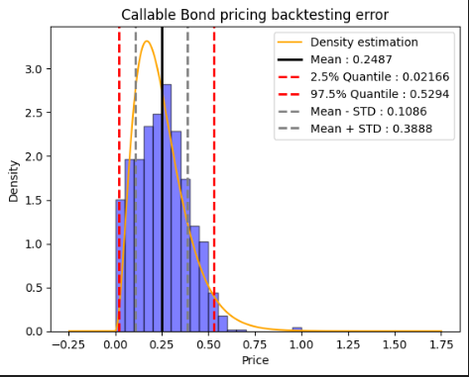
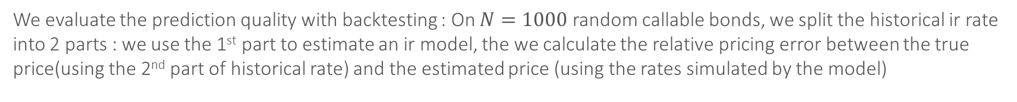
Prediction quality
We evaluate the prediction quality with backtesting : On $N=1000$ random callable bonds, we split the historical ir rate into 2 parts : we use the 1st part to estimate an ir model, the we calculate the relative pricing error between the true price(using the 2nd part of historical rate) and the estimated price (using the rates simulated by the model)
HMCEV Vasicek CIR

Slide 28
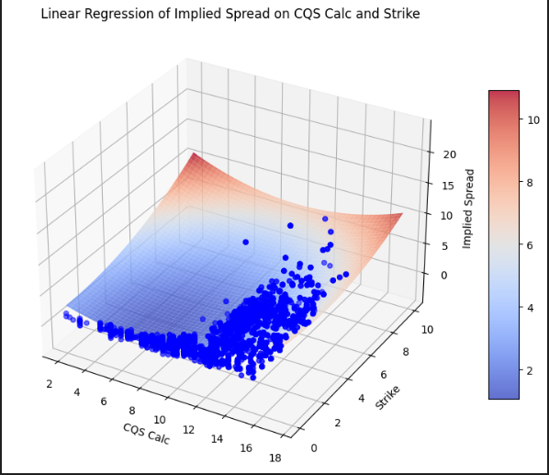
Modeling implied spread surface
Calculate implied spread for each instrument can be very time consuming and create overfitting issue ,so we decided to calculate it directly with bond CQS and Strike by calibrating an Implied spread surface

Slide 29
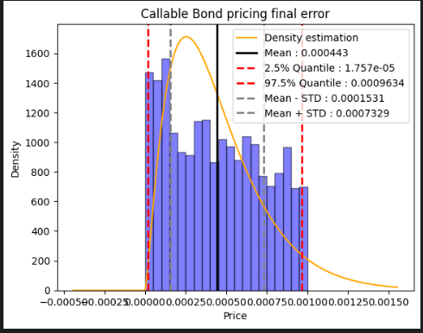
Training error

Slide 30
Q&A

